Slide 1
E-commerce with WordPress

Slide 2
The word Ecommerce reefers to the buying or selling of goods and services electronically most often through web enable transaction.

Slide 3
Ecommerce site using the publishing platform WordPress along with popular ecommerce plugin woo Commerce.
Requirements for Woo Commerce.
Alternative of woo Commerce.
Benefit of woo Commerce.
Support of Woo Commerce.
So to start lets take a big picture overview ,How ecommerce work.

Slide 4

HOW?

Slide 5


Slide 6
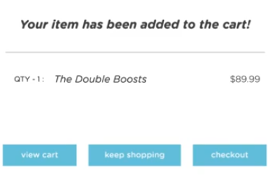
A good online store will engaged the user and encourage them too add more things to their cart.

Slide 7
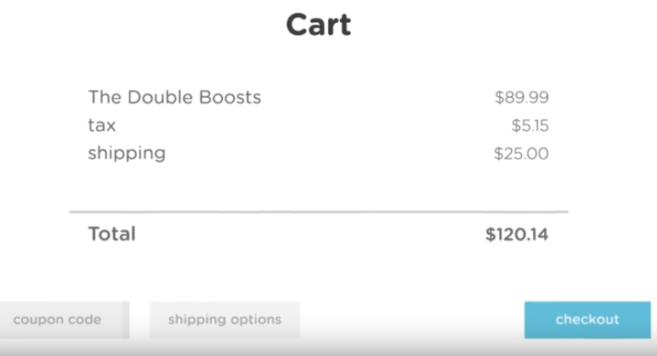

Slide 8
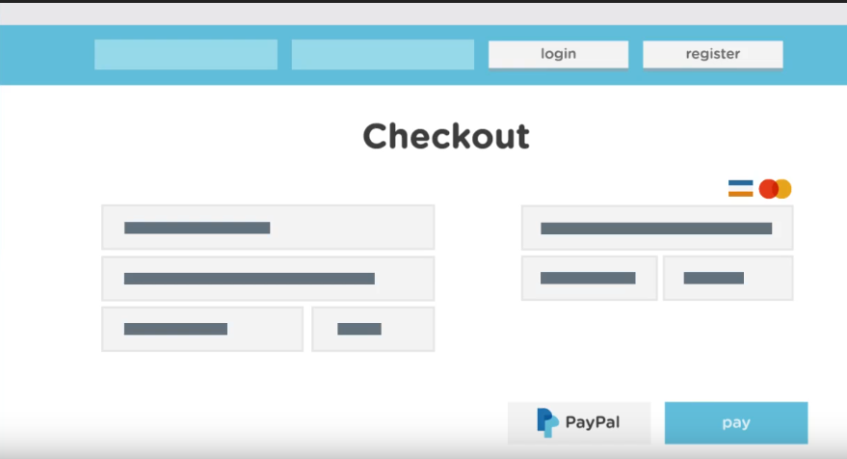

Slide 9
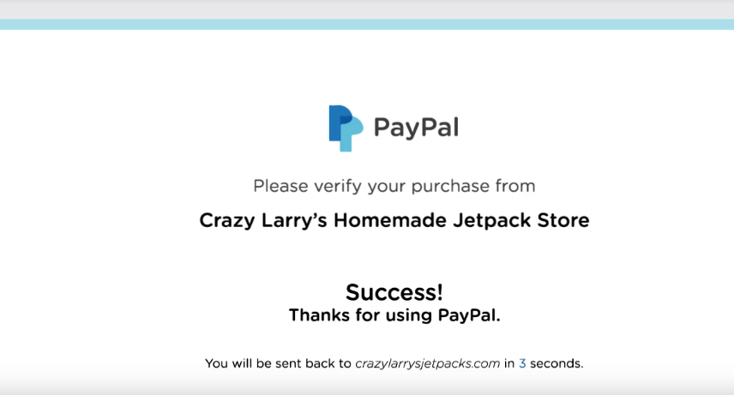

Slide 10
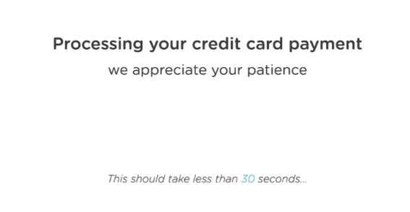

Slide 11
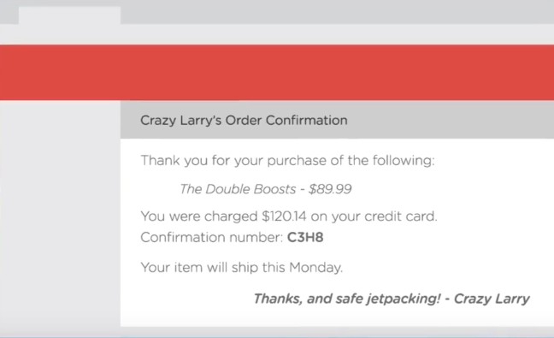

Slide 12
Some different option we have for building ecommerce site with WordPress.

Slide 13
Traditional
Managing content in WordPress
Onsite checkout
Custom theming option

Slide 14


Slide 15
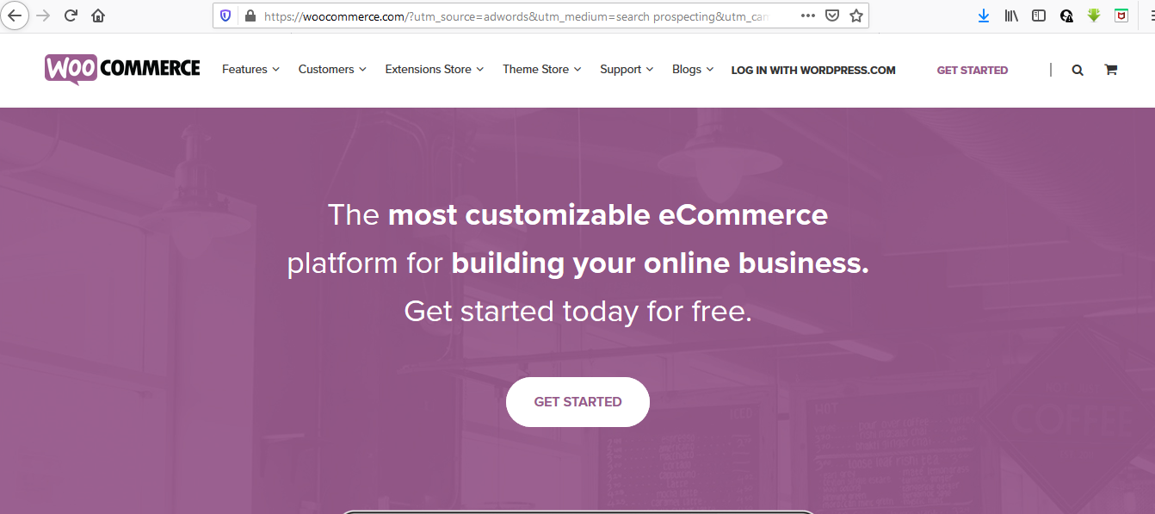

Slide 16
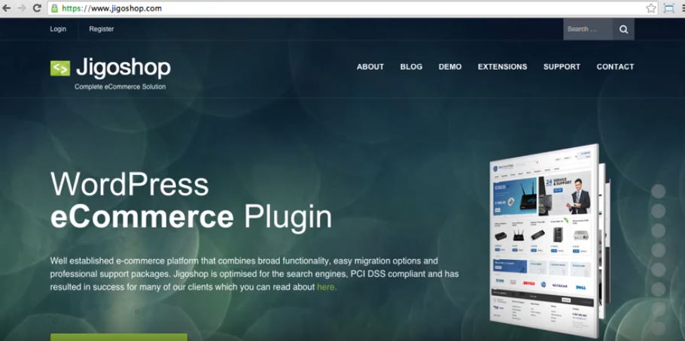

Slide 17
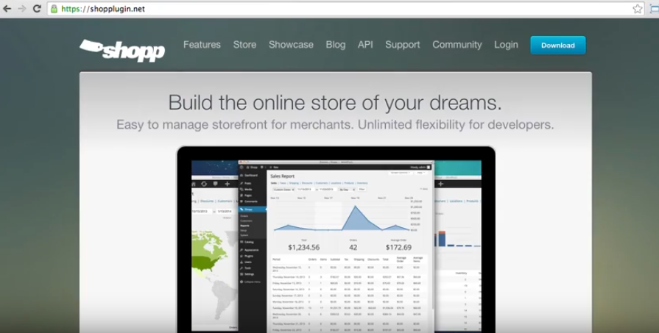

Slide 18
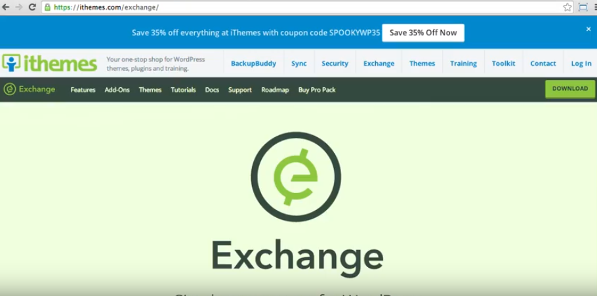

Slide 19
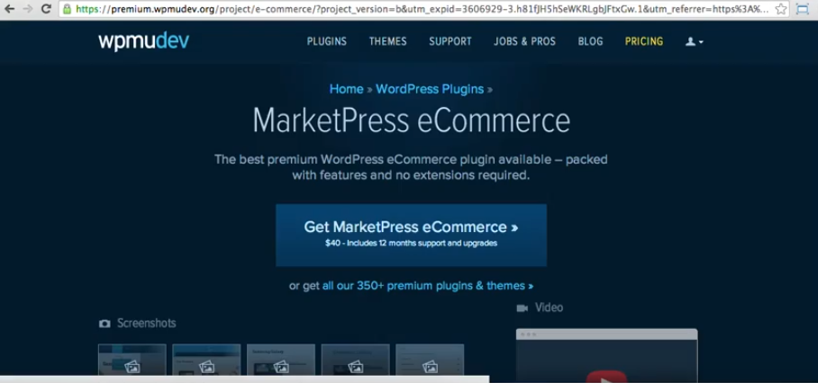

Slide 20

Hosted Ecommerce

Slide 21
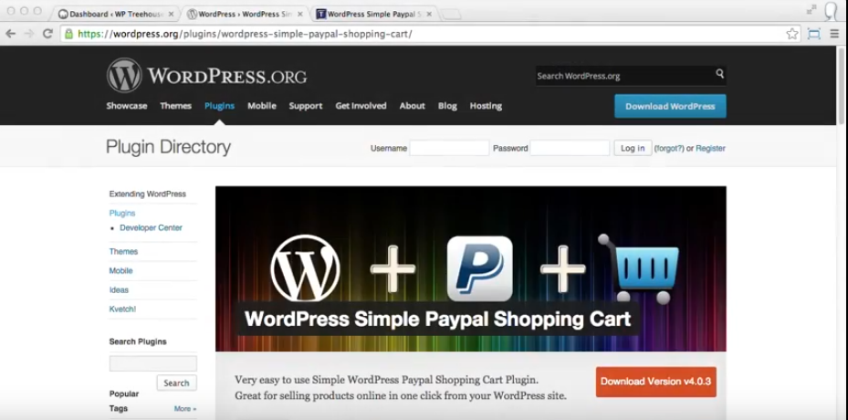

Slide 22
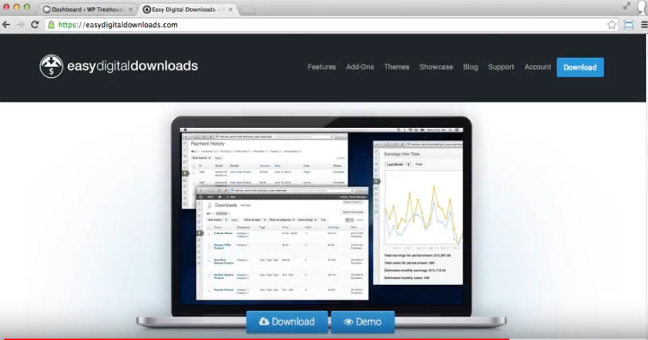
Easy digital downloads

Slide 23

Why Woo Commerce ?

Slide 24
wooCommerce
A lot of site run on wooCommerce.
Themes availability and compatibility.
Template hierarchy.
Feature rich.
Lot of extension.
Its free.
Support.

Slide 25
Support
Documentation
Direct support
WooCommere khowledgebase articles.
Community .

Slide 26
Thank you

